Slide 1
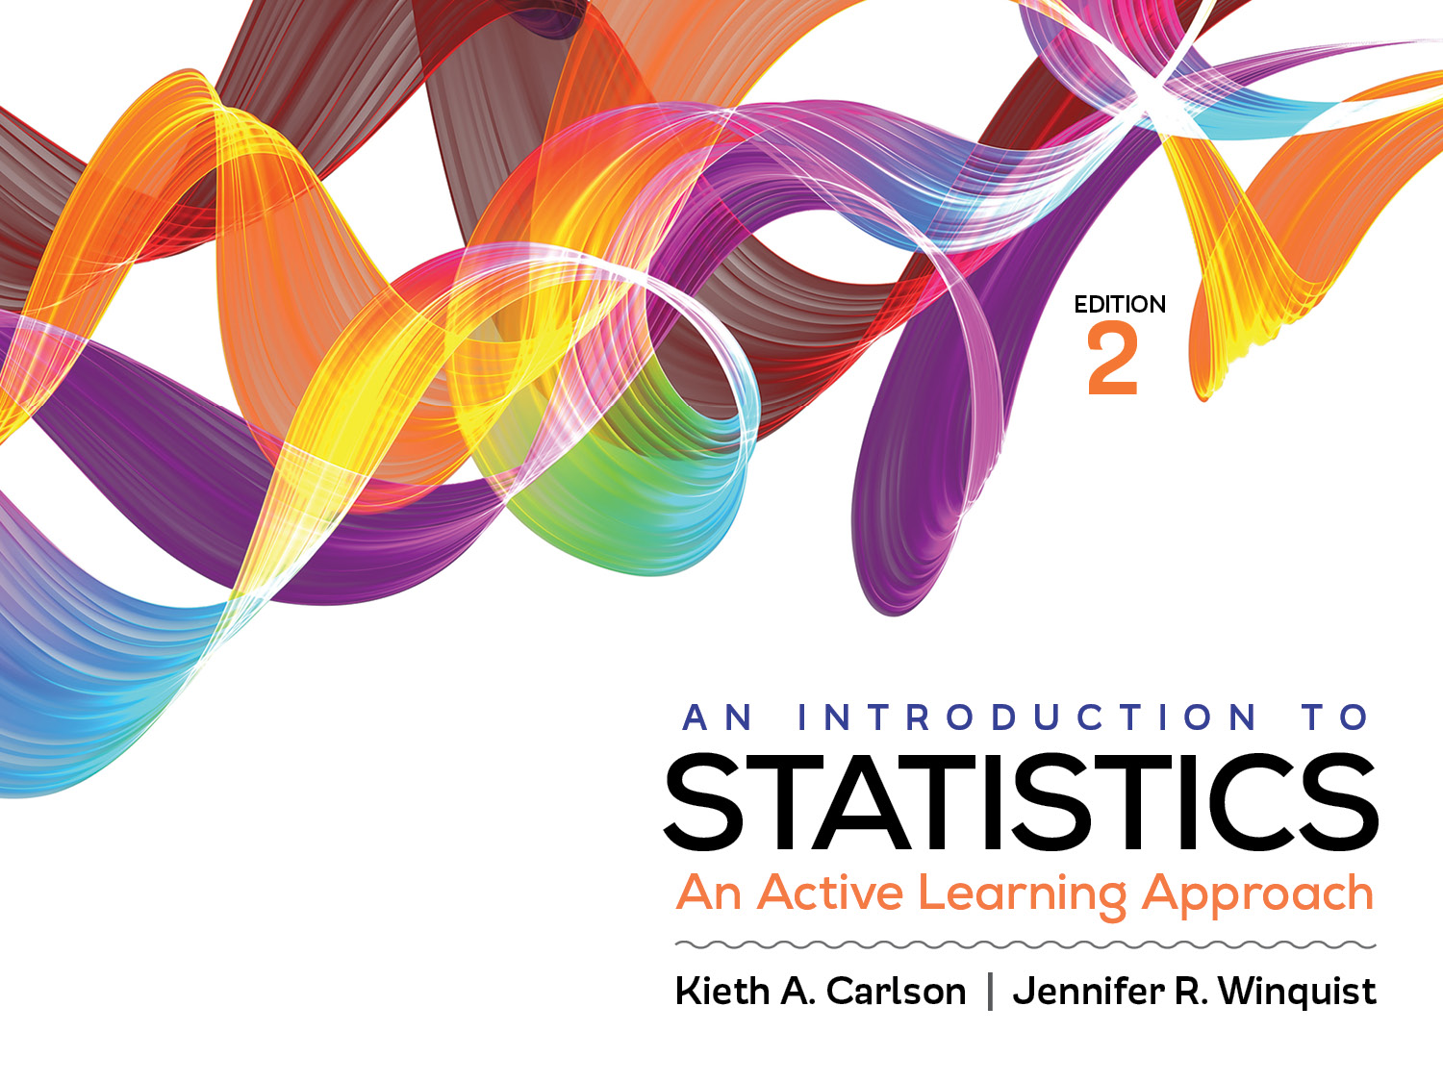
Introduction to Activity 13.2
Confidence Intervals for Correlations

Slide 2
Activity 13.2 will require you to:
Compute and interpret confidence intervals (CIs) for correlations

Slide 3




Example
Estimate the correlation in the population between variable A and variable B
r_{AB} = .48, convert to z using Appendix G → .5230
N = 53
z_{CI} for a 95% CI always= 1.96; 2.58 for a 99% CI
Use the following formulas
$$UB=\left(z_{r}\right)+(z_{CI})\left(\frac{1}{\sqrt{N−3}}\right)$$
$$LB=\left(z_{r}\right)−(z_{CI})\left(\frac{1}{\sqrt{N−3}}\right)$$
$$UB=\left(.5230\right)+(1.96)\left(\frac{1}{\sqrt{N−3}}\right)$$
$$LB=\left(.5230\right)−(1.96)\left(\frac{1}{\sqrt{N−3}}\right)$$

Slide 4
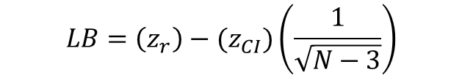
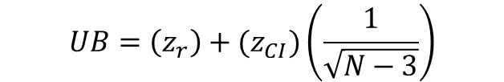
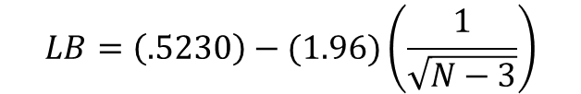
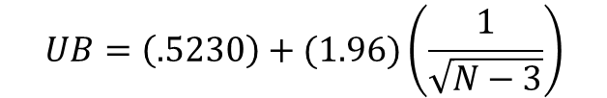
Example
$$UB=\left(z_{r}\right)+(z_{CI})\left(\frac{1}{\sqrt{N−3}}\right)$$
$$LB=\left(z_{r}\right)−(z_{CI})\left(\frac{1}{\sqrt{N−3}}\right)$$
$$UB=\left(.5230\right)+(1.96)\left(\frac{1}{\sqrt{N−3}}\right)$$
$$LB=\left(.5230\right)−(1.96)\left(\frac{1}{\sqrt{N−3}}\right)$$
$$UB=.800$$
$$LB=.24582$$
Now you must convert these z scores back to rs using Appendix G; find the above values in the z column and r value you need is to its left
UB = .66 LB = .24
95% CI [ .24, .66]—We are 95% confidence that the correlation between these two variables in the population is between .24 and .66, inclusive.

